Slide 1
Azure Machine Learning SDK with Azure Databricks
ML Platform
Parashar Shah
Senior Program/Product Manager, Azure ML Platform
@parashar (Twitter)

Slide 2
Agenda
Overview of Azure Machine Learning SDK (AML SDK)
Demo
How to setup Azure Databricks with AML SDK
Use AML SDK to train your model with Azure Databricks
Deploy the model as an auto scalable webservice in Azure
Automated Machine Learning on Azure Databricks
QnA

Slide 3






Machine Learning on Azure
Sophisticated pretrained models
To simplify solution development
…
Vision
Speech
Language
Azure Search
Popular frameworks
To build advanced deep learning solutions
Pytorch
TensorFlow
Keras
Onnx
Productive services
To empower data science and development teams
Azure Databricks
Azure Machine Learning
Machine Learning VMs
Powerful infrastructure
To accelerate deep learning
CPU
GPU
FPGA
Flexible deployment
To deploy and manage models on intelligent cloud and edge
On-premises
Cloud
Edge

Slide 4



Productive services Empower data science and development teams
Integrated data science & data engineering teams
Desktop solutions not adequate
Need a unified big data & machine learning solution
Individual data scientists
Desktop solutions adequate
Need cloud for sporadic compute needs
+
Azure Databricks
Azure Machine Learning service
Machine Learning VMs
Notes:
We realize that companies are at different stages of building data science teams.
From a sales perspective, we would like you to focus on companies that are building end to end big data and machine learning solutions as this where you will drive maximum amount of Azure consumption.
For these customers, we recommend starting with Azure Databricks and enhancing the ML experience with Azure Machine Learning.
Now we also realize that a good number of projects that are not done on big data or by big integrated teams.
For these customers, we have a set of Machine Learning VMs that are pre-provisioned with popular open source tools and packages. These are essentially desktops in the cloud that enable data scientists to quickly get up and running for their projects.
Let’s look at how we use Azure Databricks and Azure ML together.

Slide 5
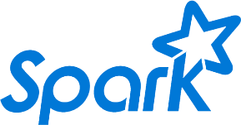
Azure Databricks
Azure Databricks
Collaborative Workspace
IoT / streaming data
Machine learning models
DATA ENGINEER
DATA SCIENTIST
BUSINESS ANALYST
Deploy Production Jobs & Workflows
Cloud storage
BI tools
MULTI-STAGE PIPELINES
JOB SCHEDULER
NOTIFICATION & LOGS
Data warehouses
Optimized Databricks Runtime Engine
Data exports
Hadoop storage
DATABRICKS I/O
APACHE SPARK
SERVERLESS
Rest APIs
Data warehouses
Enhance Productivity
Build on secure & trusted cloud
Scale without limits
Notes:
Databricks, founded by the team that created Apache Spark – unified analytics platform that accelerates innovation by unifying data science, engineering & business.
75% of the code committed to Apache Spark comes from Databricks
Unified Runtime
Create clusters in seconds, dynamically scale them up and down.
They’ve made enhancements to Spark engine to make it 10x faster than open source Spark
Serverless- Auto-configured multi-user cluster, Reliable sharing with fault isolation
Unified Collaboration
Overall – a simple & collaborative environment that enables your entire team to use Spark & interact with your data simultaneously
DE – Improve ETL performance, zero management clusters. Execute production code from within notebooks
DS - For data scientists, easy data exploration in notebooks
Business SME – interactive dashboards empower teams to create dynamic reports
Enterprise Security
Encryption
Fine grained Role-based access control (files, clusters, code, application, dashboard)
Compliance
Rest APIs
DE – DBIO, SPARK, API’s , JOBS
DS – Spark and Serverless, Interactive Data Science
Data Products - Everything
Creators of Spark
Training People
Number of Customers
Ingest
Workflow
Schedule / Run / Monitor
Execute
Troubleshoot
Debug
Production Jobs
---------
Ingest, ETL, Scheduling, Monitoring

Slide 6
Azure Machine Learning New capabilities
Use the tools of your choice with Azure Machine Learning Python SDK
Build and train models locally, with remote VMs or managed, auto-scaled compute
Track experiments for reproducibility and auditing needs.
Identify and promote your best models
Deploy and manage your models using containers to run them anywhere
Monitor your models performance from a single location
Notes:
We realize that companies are at different stages of building data science teams.
From a sales perspective, we would like you to focus on companies that are building end to end big data and machine learning solutions as this where you will drive maximum amount of Azure consumption.
For these customers, we recommend starting with Azure Databricks and enhancing the ML experience with Azure Machine Learning.
Now we also realize that a good number of projects that are not done on big data or by big integrated teams.
For these customers, we have a set of Machine Learning VMs that are pre-provisioned with popular open source tools and packages. These are essentially desktops in the cloud that enable data scientists to quickly get up and running for their projects.
Let’s look at how we use Azure Databricks and Azure ML together.

Slide 7
Demo - e2e Azure Machine Learning with Azure Databricks https://aka.ms/aml-notebook-databricks-e2e and https://github.com/Azure/MachineLearningNotebooks

Slide 8
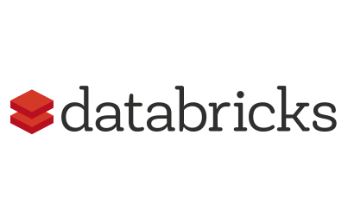

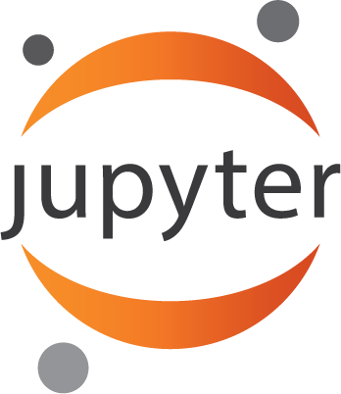




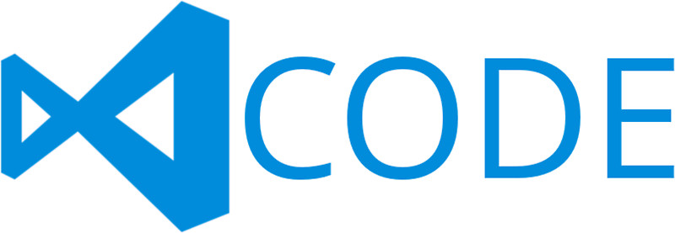

Azure Machine Learning SDK (summary)
Prepare
Experiment
Deploy
…
Prepare Data
Build model (your favorite IDE)
Train & Test Model (Manual or Automated)
Register and Manage Model
Build Image
Deploy A Scalable Service &
Monitor Model

Slide 9


Learn more: https://aka.ms/aml-docs
Notebooks- https://aka.ms/aml-notebook-databricks-e2e
Try it for free
AI TechTalk: Azure Machine Learning SDK - a walkthrough https://myignite.techcommunity.microsoft.com/sessions/66265
AI with Azure Machine Learning services: Simplifying the data science process https://myignite.techcommunity.microsoft.com/sessions/66248
AI for an intelligent cloud and intelligent edge: Discover, deploy, and manage with Azure ML services https://myignite.techcommunity.microsoft.com/sessions/65389
Generating high quality models efficiently using Automated ML and Hyperparameter Tuning - https://myignite.techcommunity.microsoft.com/sessions/66245
Summary blog & there are more - https://azure.microsoft.com/en-us/blog/what-s-new-in-azure-machine-learning-service/
Parashar Shah
@parashar (Twitter)

